Slide 1
Data Representations Grids and Interpolation

Slide 2
The Visualization Pipeline
simulation
data bases
sensors
data acquisition
raw data
filtering
vis data
The Visualization Pipeline
mapping
renderable representation
rendering
images, video
interaction

Slide 3
Agenda
Data Representation
Data domains
Data structures (grids)
Data interpolation
Data differentiation

Slide 4
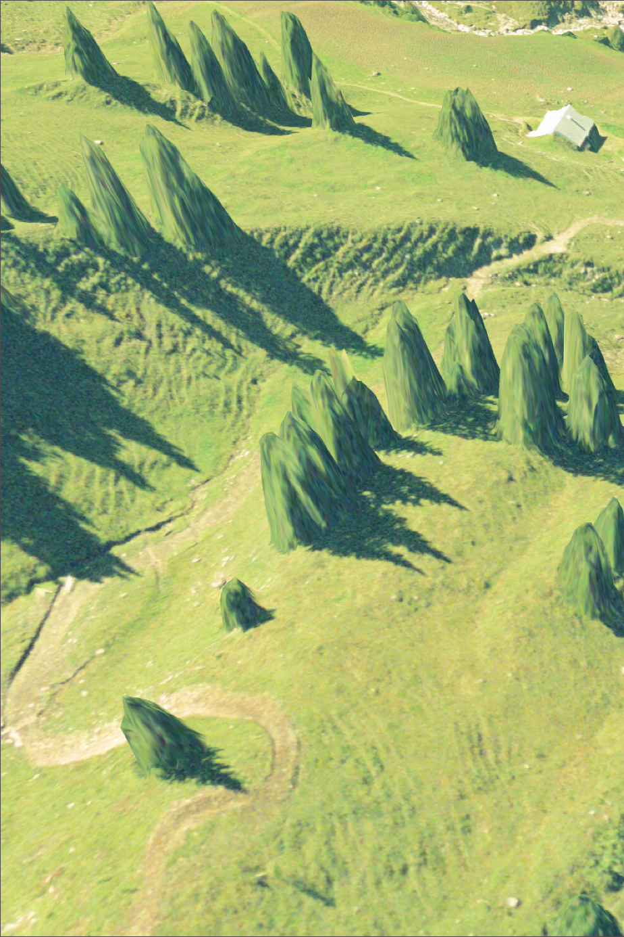
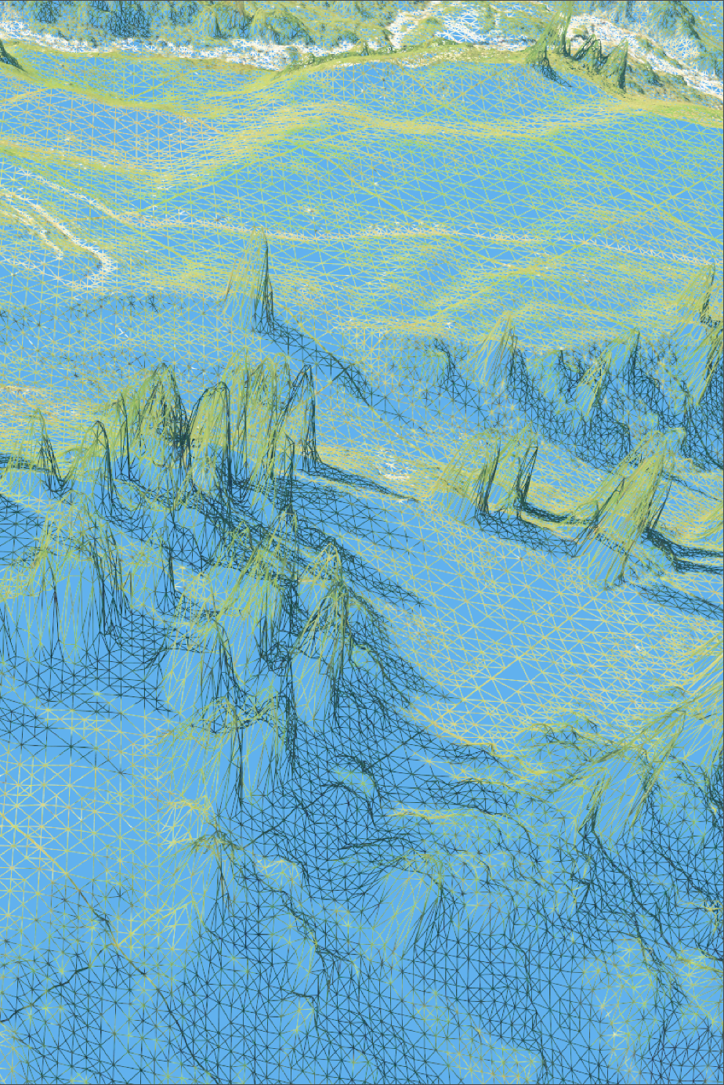
Digital Data

Slide 5
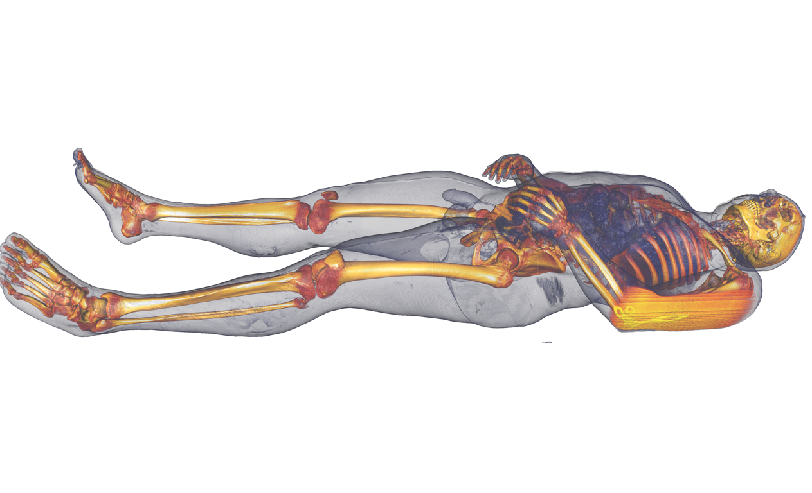
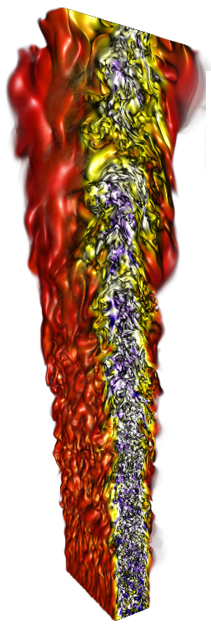
Scientific Data

Slide 6
Data Representation
X
spatial domain
data values
independent
variables
dependent
variables

Slide 7
Data Representation
In most cases, the visualization data represent a continuous real object, e.g., an oscillating membrane, a velocity field around a body, an organ, human tissue, etc.
This object lives in an n-dimensional space - the domain
Usually, the data is only given at a finite set of locations, or samples, in space and/or time
Remember imaging processes like numerical simulation and CT-scanning, note similarity to pixel images
We call this a discrete structure, or a discrete representation of a continuous object

Slide 8
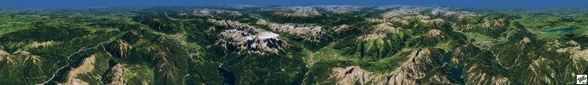
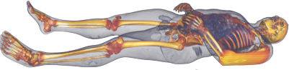
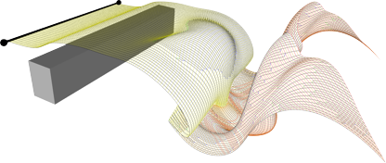
Data Representation
Discrete representations
We usually deal with the reconstruction of a continuous real object from a given discrete representation
Discrete structures consist of samples, from which grids / meshes consisting of cells are built.

Slide 9
Data Representation
Discrete representations
We usually deal with the reconstruction of a continuous real object from a given discrete representation
Discrete structures consist of point samples
Often, we build grids/meshes that connect neighboring samples
?

Slide 10
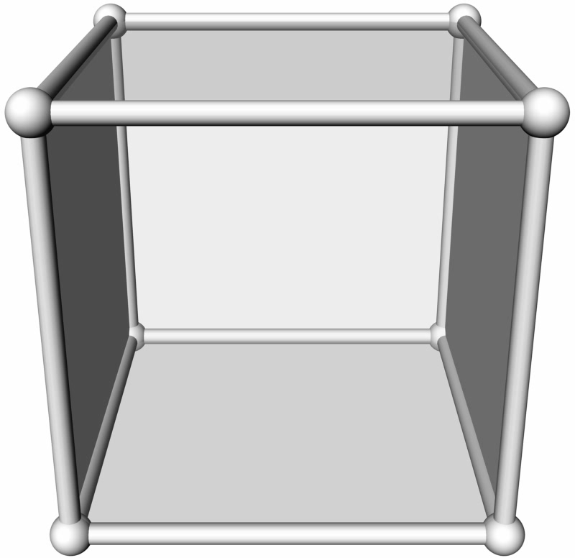
Data Representation
Grid terminology
0D: grid vertex
(grid point)
1D: grid line
2D: grid face
3D: grid voxel
grid vertices
grid lines
grid faces
grid cell: largest-dimensional element in a grid
2D: grid face
3D: grid voxel

Slide 11
Grids and Interpolation
Data Connectivity
There are different types of grids:
Structured grids connectivity is implicitly given.
Block-structured grids combination of several structured grids
Unstructured grids connectivity is explicitly given.
Hybrid grids combination of different grid types

Slide 12
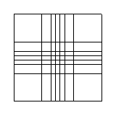
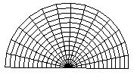
Grids
Structured grids
“Structured” refers to the implicitly given connectivity between the grid vertices
We distinguish different types of structured grids regarding the alignment to the coordinate system and the size of cells
uniform grid
axis-aligned, identical cells implicitly given coordinates
rectilinear grid
axis-aligned, cells different size semi-implicitly given coordinates
curvilinear grid
not axis-aligned, cells different size
explicitly given coordinates

Slide 13
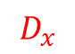
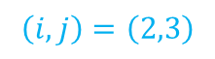
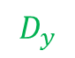

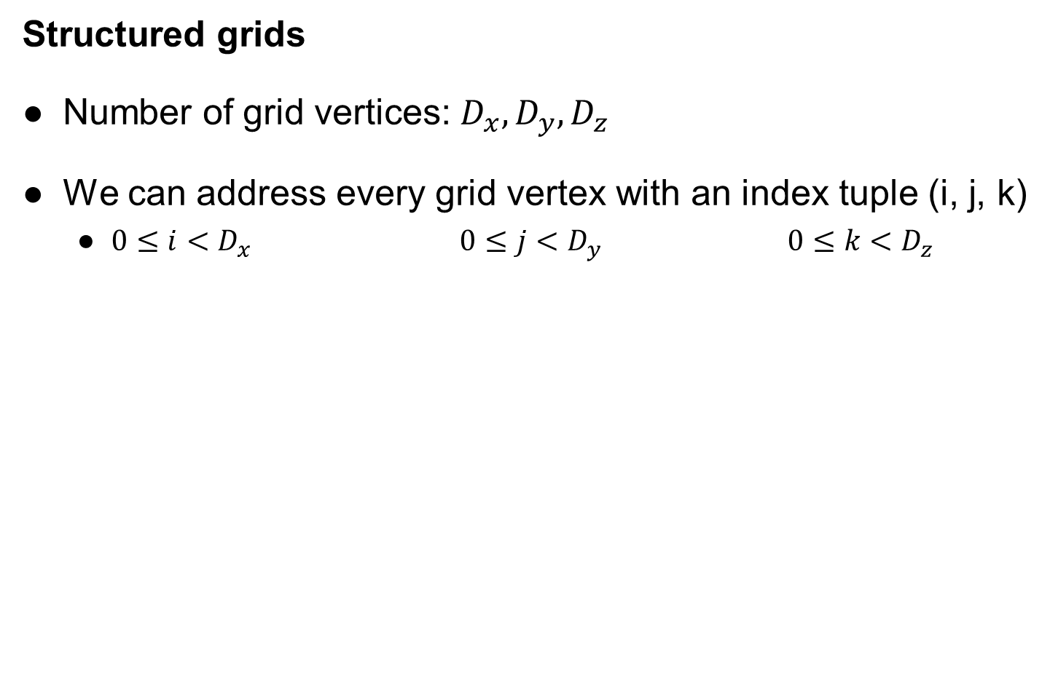

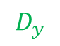
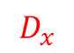

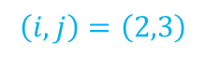
Grids and Interpolation
Structured grids
Number of grid vertices: $D_{x}, D_{y}, D_{z}$
We can address every grid vertex with an index tuple (i, j, k)
$0≤i<D_{x}$ $0≤j<D_{y}$ $0≤k<D_{z}$
$$\left(i,j\right)=\left(2,3\right)$$
$$\left(i,j\right)=\left(2,3\right)$$
$$\left(i,j\right)=\left(2,3\right)$$
$$D_{y}$$
$$D_{y}$$
$$D_{y}$$
$$D_{x}$$
$$D_{x}$$
$$D_{x}$$
uniform grid
axis-aligned, identical cells implicitly given coordinates
rectilinear grid
axis-aligned, cells different size semi-implicitly given coordinates
curvilinear grid
not axis-aligned, cells different size
explicitly given coordinates

Slide 14
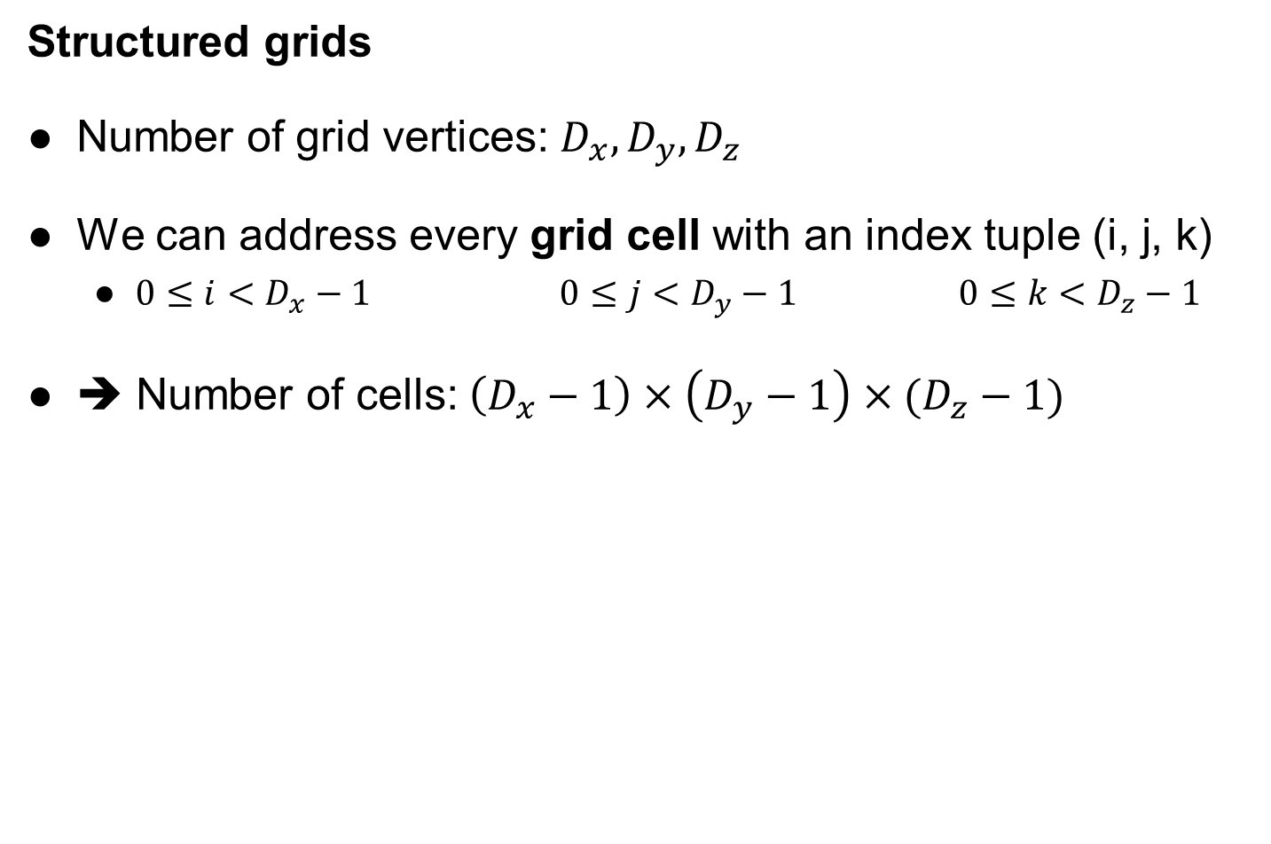
Grids and Interpolation
Structured grids
Number of grid vertices: $D_{x}, D_{y}, D_{z}$
We can address every grid cell with an index tuple (i, j, k)
$0≤i<D_{x}−1$ $0≤j<D_{y}−1$ $0≤k<D_{z}−1$
➔ Number of cells: $\left(D_{x}−1\right)×\left(D_{y}−1\right)×(D_{z}−1)$
$$D_{y}$$
$$D_{y}$$
$$D_{y}$$
$$D_{x}$$
$$D_{x}$$
$$D_{x}$$
uniform grid
axis-aligned, identical cells implicitly given coordinates
rectilinear grid
axis-aligned, cells different size semi-implicitly given coordinates
curvilinear grid
not axis-aligned, cells different size
explicitly given coordinates

Slide 15
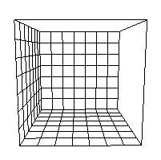
Grids and Interpolation
very important
Regular or uniform grids
Cells are rectangles or rectangular cuboids of the same size
All grid lines are parallel to the axes
To define a uniform grid, we need the following:
Bounding box: (x_{min}, y_{min}, z_{min}) - (x_{max}, y_{max}, z_{max})
Number of grid vertices in each dimension: D_{x}, D_{y}, D_{z}
➔ Cell size: d_{x}, d_{y}, d_{z}

Slide 16
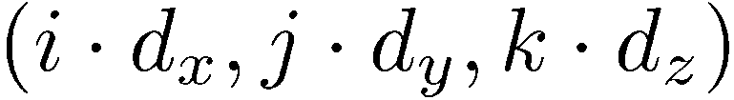
Grids and Interpolation
Regular or uniform grids
Well suited for image data (medical applications)
Coordinate ➔ cell is very simple and cheap
Global search is good enough; local search not required
Coordinate of a grid vertex:
+ start point

Slide 17
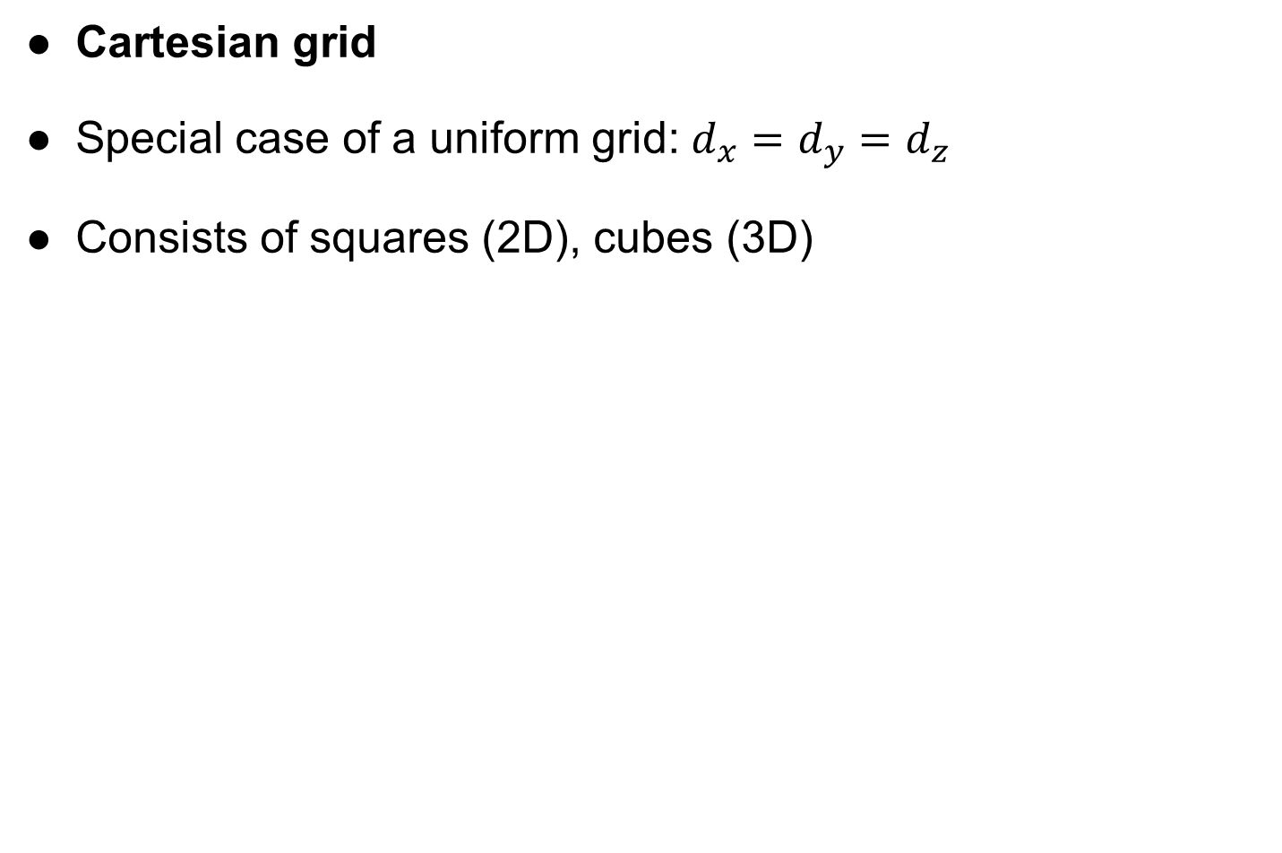
Grids and Interpolation
Cartesian grid
Special case of a uniform grid: $d_{x}=d_{y}=d_{z}$
Consists of squares (2D), cubes (3D)

Slide 18
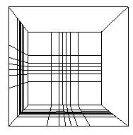
Grids and Interpolation
Rectilinear grids
Cells are rectangles of different sizes
All grid lines are parallel to the axes
Vertex locations are inferred from positions of grid lines for each dimension:
XLoc = {0.0, 1.5, 2.0, 5.0, …}
YLoc = {-1.0, 0.3, 1.0, 2.0, …}
ZLoc = {3.0, 3.5, 3.6, 4.1, …}
Coordinate ➔ cell still quite simple

Slide 19
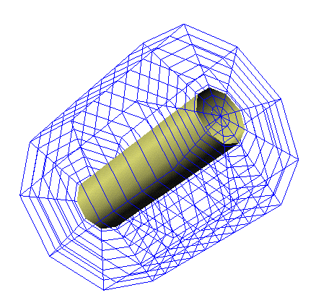
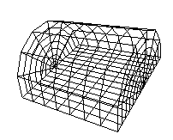
Grids and Interpolation
Curvilinear grids
Vertex locations are explicitly given
XYZLoc = {(0.0, -1.0, 3.0), (1.5, 0.3, 3.5), (2.0, 1.0, 3.6), …}
Cells are quadrilaterals or cuboids
Grid lines are not (necessarily) parallel to the axes
2D curvilinear grid
3D curvilinear grids

Slide 20
Grids and Interpolation
Curvilinear grids
Coordinate ➔ cell:
Local search within last cell or its immediate neighbors
Global search via quadtree/octree
2D curvilinear grid
3D curvilinear grids

Slide 21
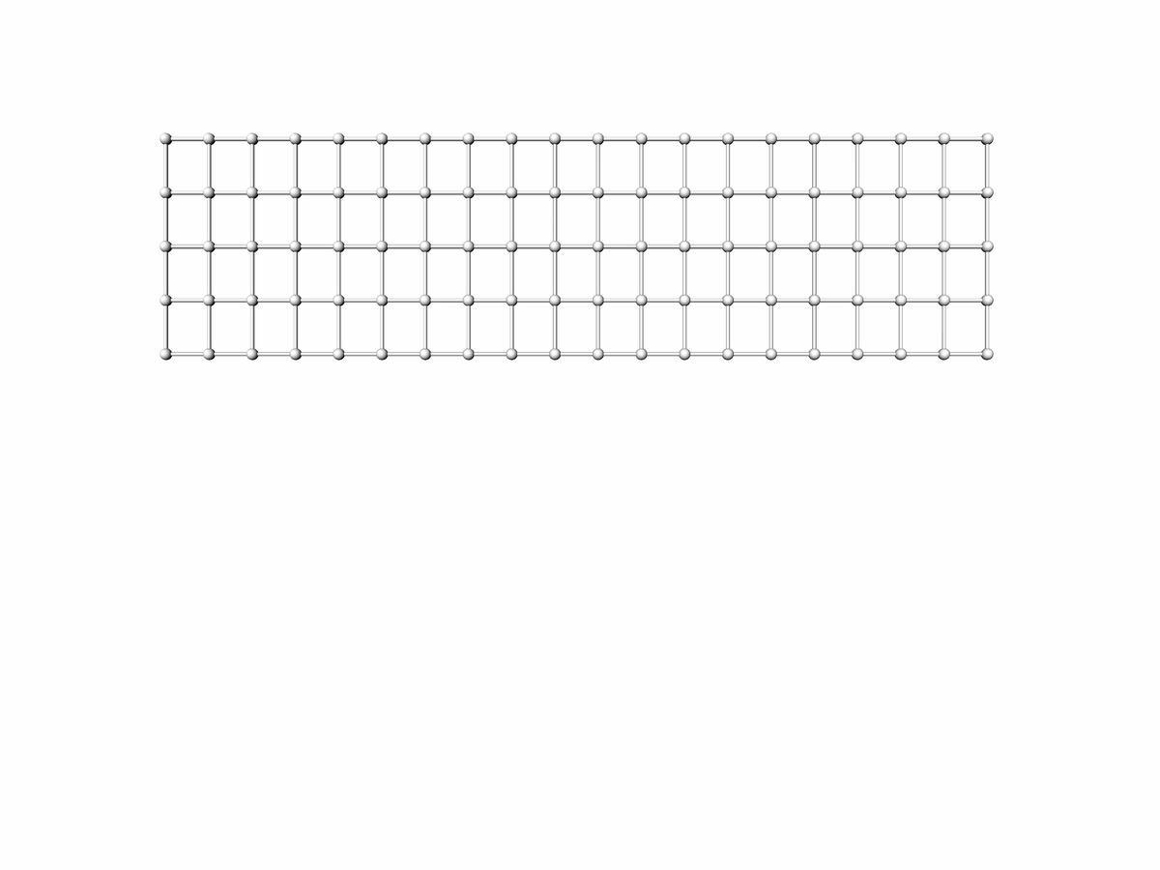
Grids and Interpolation

Slide 22
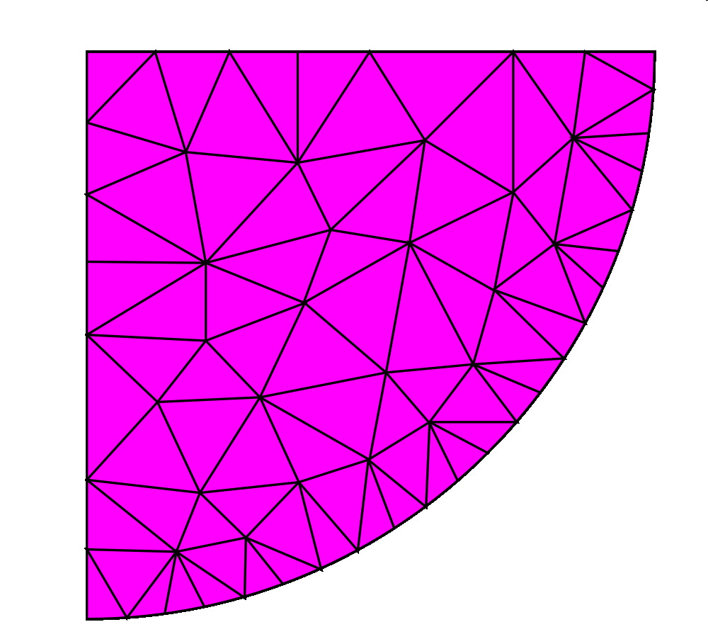
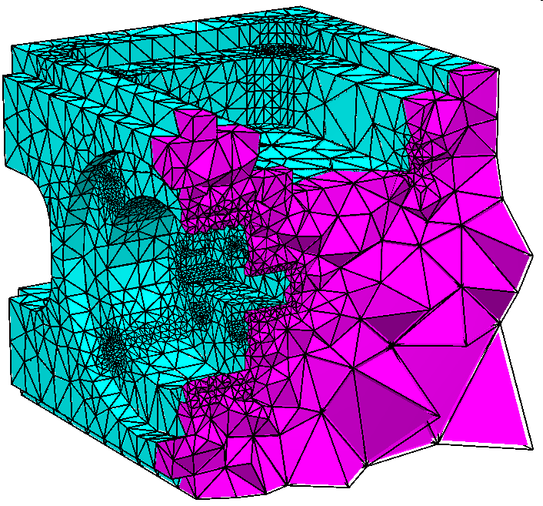
Grids and Interpolation
Unstructured grids
2D unstructured grid
consisting of triangles
3D unstructured grid
consisting of tetrahedra
(from TetGen user manual)

Slide 23
Grids and Interpolation
Unstructured grids
Vertex locations and connectivity explicitly given
Linear interpolation within a triangle/tetrahedron using barycentric coordinates
Coordinate ➔ triangle/tetra:
Local search within last triangle/tetra or its immediate neighbors
Global search via quadtree/octree
3D unstructured grid
consisting of tetrahedra
(from TetGen user manual)

Slide 24
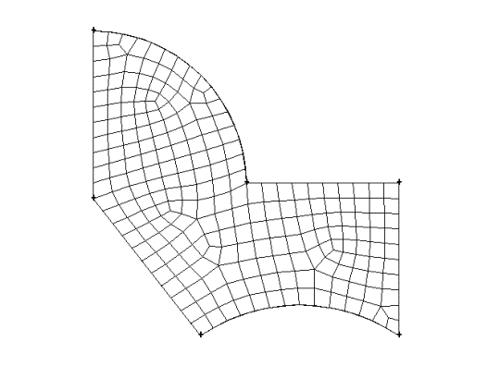
Grids and Interpolation
Unstructured grids
2D unstructured grid
consisting of quads
Source: https://www.sharcnet.ca/Software/Gambit/html/modeling_guide/mg0303.htm

Slide 25
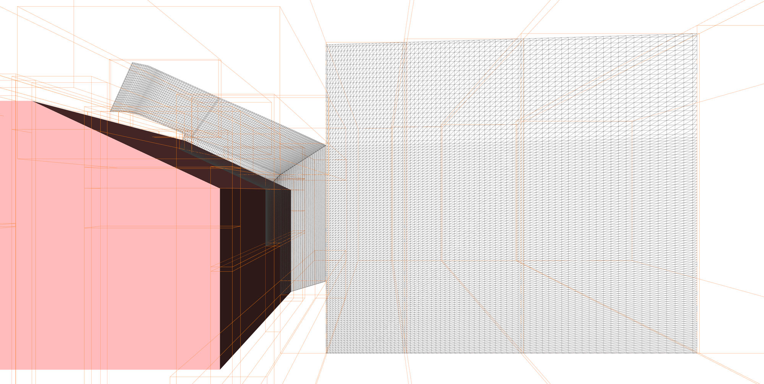
Grids and Interpolation
Block-structured grids
combination of several structured grids
DFG-funded SFB 557
Erik Wassen, TU Berlin, Germany 2008

Slide 26
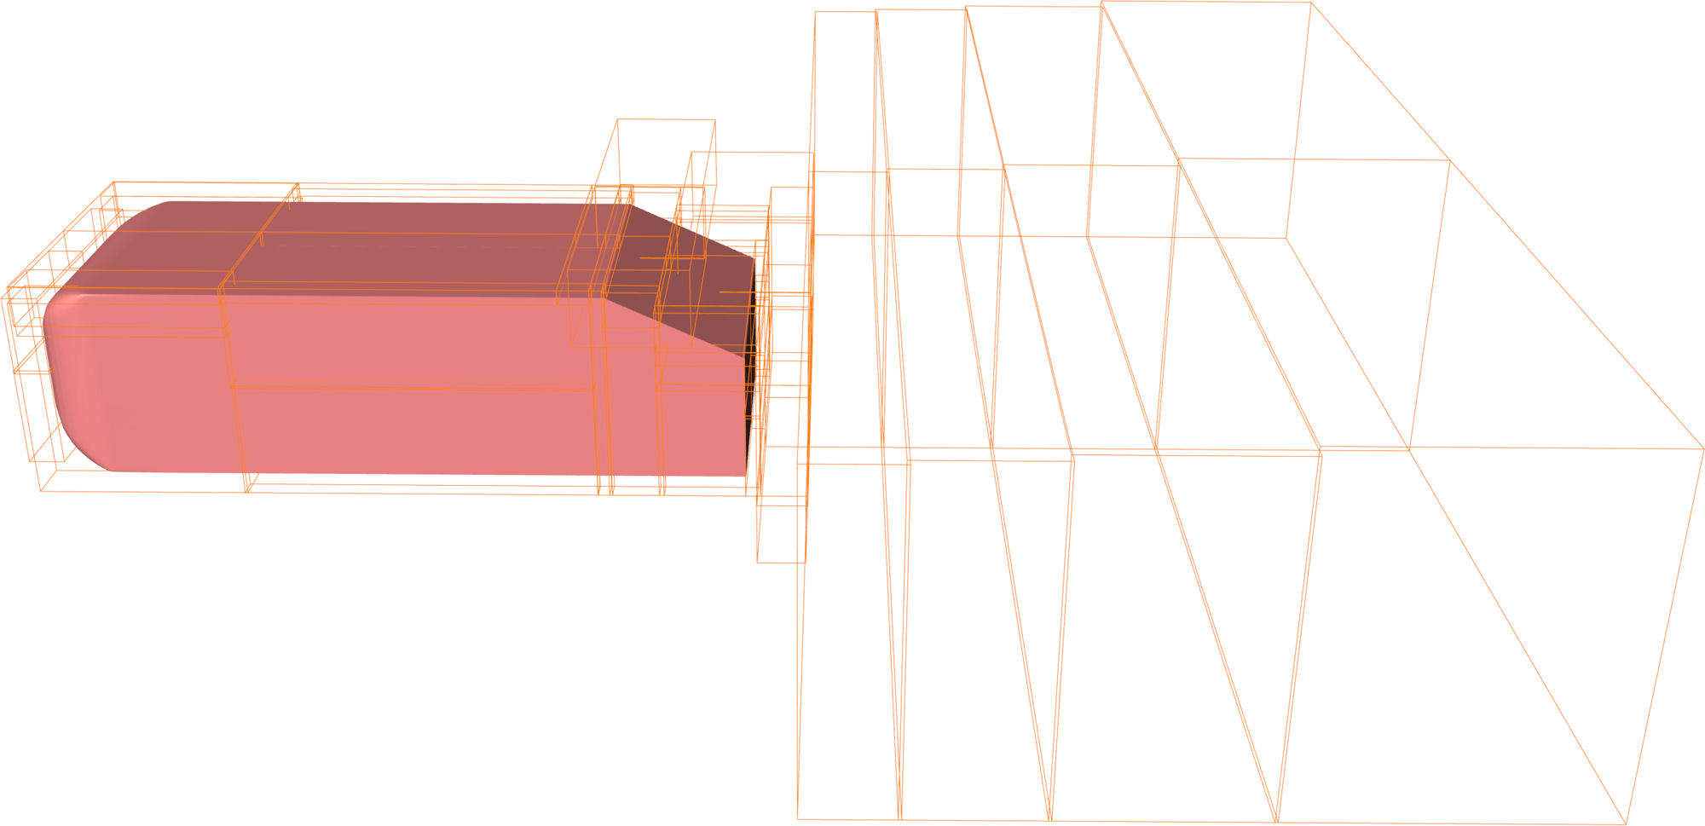
Visualization Scenarios
Demands on data storage, an example:
Ahmed body
Block-structured grid with 52 blocks
Each block is a curvilinear grid
17 million grid cells in total
Temporal resolution: a particle needs 10000 time steps from front to back of the Ahmed body
DFG-funded SFB 557
Erik Wassen, TU Berlin, Germany 2008

Slide 27
Visualization Scenarios
Demands on data storage, an example:
17 million grid cells
x 10000 time steps
x 7 variables
X 8 bytes per double
= 8.66 terra bytes
(60.62 TB for total 70000 time steps)
DFG-funded SFB 557
Erik Wassen, TU Berlin, Germany 2008
➔ Do not save every time step, not every variable, and not every block.

Slide 28
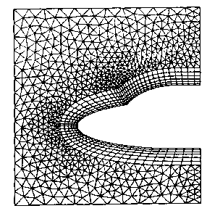
Grids and Interpolation
Hybrid grids
combination of different grid types
2D hybrid grid

Slide 29
Interpolation
A grid consists of a finite number of samples
The continuous signal is known only at a few points (data points)
In general, data is needed in between these points
By interpolation we obtain a representation that matches the function at the data points
Reconstruction at any other point possible
?

Slide 30
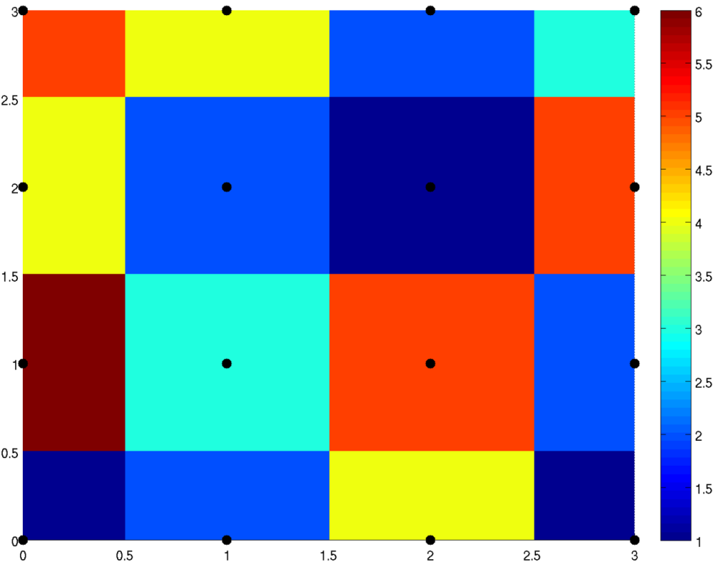
Interpolation
Simplest approach: Nearest-Neighbor Interpolation
Assign the value of the nearest grid point to the sample.

Slide 31

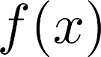
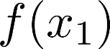
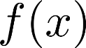
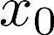
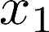
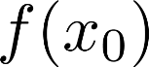
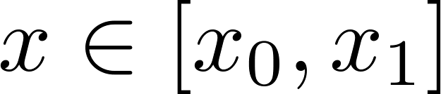
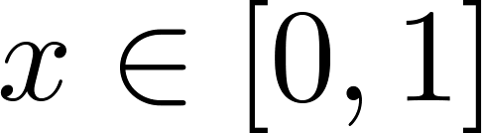
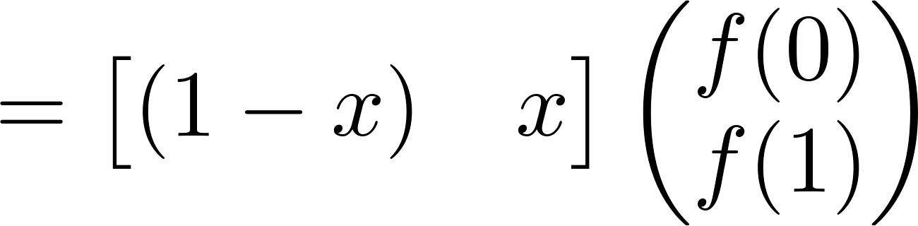
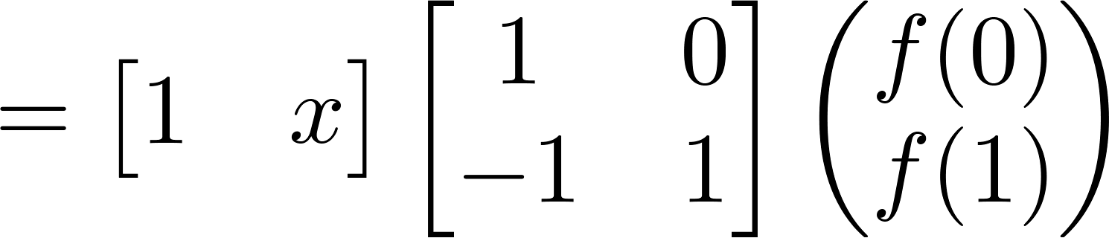
Interpolation
Linear Interpolation (in 1D domain)
Domain points , scalar function
General:
Special Case:
Basis
Coefficients

Slide 32
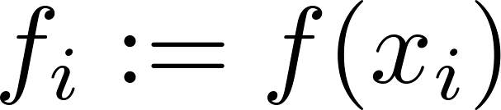
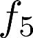
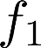
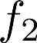
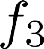
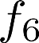
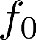
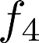








Interpolation
Linear Interpolation (in 1D domain)
Sample values
Continuity (discontinuous first derivative)
Use higher order interpolation for smoother transition, e.g., cubic interpolation

Slide 33






Interpolation
Cubic Hermite Interpolation (in equidistant 1D domain)
Linear
Cubic
“interpolate values and derivatives at
and “
Continuity (discontinuous second derivatives)
Linear
Cubic
(Catmull Rom)

Slide 34


Interpolation
Interpolation in 2D, 3D, 4D, …
Tensor Product Interpolation
Perform linear / cubic … interpolation in each x,y,z … direction separately
Bi-Linear
Bi-Cubic

Slide 35







Interpolation
Tensor Product Interpolation
Extend interpolation from 1D to higher dimensions
Coefficients , associated basis functions (linear / cubic / …)
1D
2D, “bi-”
3D, “tri-”
= 3D tensor
product

Slide 36





Interpolation
Example: Linear Tensor Product Interpolation
Number of basis functions / coefficients
1D, linear

Slide 37









Interpolation
very important
Example: Linear Tensor Product Interpolation
Number of basis functions / coefficients
2D, “bi-linear”
“interpolate twice in x direction and then once in y direction”

Slide 38










Grids and Interpolation
Example: Bi-linear interpolation in a 2D cell
Repeated linear interpolation

Slide 39









Interpolation
Example: Linear Tensor Product Interpolation
Number of basis functions / coefficients
3D, “tri-linear”
“interpolate four times in x direction, twice in y direction, and once in z direction”

Slide 40



Function Derivatives
Function Derivative Estimation
Called Gradients for multidimensional functions
Have a lot of important applications (e.g., normal for volume rendering, critical point classification for vector field topology …)
Describes direction of steepest ascend
“vector of partial derivatives“

Slide 41
Function Derivatives
Two ways to estimate gradients:
Direct derivation of interpolation formula
Finite differences schemes

Slide 42




Field Function Derivatives
Field Function Derivatives, Bi-Linear
derive this interpolation formula
“constant in x direction“
“constant in y direction“
$$∇f\left(x,y\right)=\left({\frac{∂f(x,y)}{∂x} \atop \frac{∂f(x,y)}{∂y}}\right)$$
final gradient

Slide 43
Field Function Derivatives
Problem of exact linear function differentiation: discontinuous gradients
Solution:
Use higher order interpolation scheme (cubic)
Use finite difference estimation
(Piecewise) linear function
Gradient

Slide 44








Finite Differences
Finite Differences Schemes
Apply Taylor series expansion around samples
Continuous function
Linear
function
Taylor expansion
Forward difference
Backward difference

Slide 45



Finite Differences
Finite Differences Schemes
Central differences have higher approximation order than forward / backward differences
Difference
Central difference

Slide 46

Finite Differences
Finite Differences Schemes, Higher order derivatives
1D Example, linear interpolation
(Piecewise) linear function
Central differences

Slide 47

Gridless Interpolation
What if the initial data points were not laid out on a grid?
Data is given at scattered points in the domain
In this case we can construct a mesh from the given points
This process is called triangulation
The result is a triangular mesh in 2D and a tetrahedral mesh in 3D
Interpolate linearly in each triangle

Slide 48

Generating a triangulation
Given irregularly distributed scattered points in 2D
Steps for interpolation:
Construct triangulation
Perform linear interpolation in each triangle
Since for a given set of points many triangulations exist, the challenge is to find the connectivity that constitutes a “good” triangulation

Slide 49
Finding a „good“ triangulation
For a set of points, many triangulations exist
We are interested in a triangulation with good quality
A measure for the quality of a triangulation is the aspect ratio of the so-defined triangles
Avoid long, thin ones
Consider the ratio of:
radius of incircle to radius of circumcircle
maximal to minimal angle in triangle

Slide 50
Generating a valid triangulation
How to get connectivity/triangulation from scattered data?
Voronoi diagram
Delaunay triangulation
Voronoi Diagram
Delaunay Triangulation

Slide 51



Voronoi Diagram
Voronoi Diagram
Cells associated to points (sites)
A cell contains all points that are closest to the site

Slide 52


Generating a Triangulation
Scattered data triangulation
A triangulation of data points consists of
Set of vertices (0D)
Edges (1D) connecting two vertices
Faces (2D) connecting three vertices
A triangulation must satisfy the following criteria
faces = , i.e. the union of all faces including the boundary is the convex hull of all vertices
The intersection of two triangles is either empty, or a common vertex, or a common edge

Slide 53
Invalid Triangulations
Triangulations with
holes overlapping faces T-Vertices
are not valid

Slide 54
Delaunay Triangulation
Delaunay Triangulation
The geometric dual of the Voronoi diagram
Delaunay Property: the circumcircle of a triangle contains no other vertices but the triangle vertices
Two nodes a and b are connected iff the Voronoi cells C(a) and C(b) share a common edge
Unique for all but trivial cases
Maximizes the smallest angle and (radius of in-circle)/(radius of circumcircle)
Computation
Edge Flip Algorithm
CGAL (www.cgal.org)

Slide 55
Algorithm for Delaunay triangulations
Edge flip algorithm
find all edges where local Delaunay property is violated
mark these edges and push them onto the stack
while (stack not empty)
pop edge from stack
if (edge does not satisfy Delaunay property)
flip this edge
flip all adjacent edges for which the Delaunay property is violated due to the flip

Slide 56


Interpolation in Triangles
Piecewise Linear Interpolation in Triangle Meshes

Slide 57




Interpolation in Triangles
Linear Interpolation in a Triangle
There is exactly one linear function that satisfies the interpolation constraint
A linear function can be written as
Polynomial can be obtained by
solving the linear system
Linear in and
Interpolated values along any ray in the plane spanned by the triangle are linear along that ray

Slide 58
Barycentric Coordinates
Barycentric Coordinates:
Planar case: Barycentric combinations of 3 points
Area formulation:
p₂
γ
p
α
β
p₁
p₃

Slide 59
Barycentric Coordinates
Barycentric Coordinates:
Linear formulation:
p₂
γ
p
α
β
p₁
p₃
p₂
β
p
p₁
α
p₃

Slide 60
Barycentric Coordinates
p₂
p₂
γ
p
α
α
γ
β
p₁
p₃
γ
α
p
β
p₁
β
γ
β
p₃
α
Notes:
The lines in the triangle are parallel to the sides.

Slide 61




Barycentric Interpolation
very important
Barycentric Interpolation in a Triangle
The linear function of a triangle can be computed at any point as with (Barycentric Coordinates)
This also holds for the coordinate of the triangle: → Can be used to solve for unknown coefficients :

Slide 62









Barycentric Interpolation
Barycentric Interpolation in a Triangle
Solution of (e.g. Cramer's rule):
with
Inside triangle criteria

Slide 63
Barycentric Interpolation
Barycentric Interpolation in a Tetrahedron
Analogous to the triangle case

Slide 64
Barycentric Interpolation
Gradient of a linearly interpolated function in a triangle/tetrahedron
Constant!

Slide 65


Grids and Interpolation
There is a variety of further scattered data interpolation schemes, e.g., radial basis functions.
One of them is the Shepard approach:
The weight function w_{k}(x,y) is constructed in such a way that the impact of an observation point decreases far away from the observation point, i.e.,

Slide 66


Shepard Interpolation (Inverse Distance Weighting)

Slide 67




Grids and Interpolation
For this choice of , all data values have global impact.
Using the Franke Little weight function, local impact can be achieved.
2D Voronoi diagram
Shepard interpolation
Notes:
R-nearest neighbors

Slide 68
Grids and Interpolation
Summary
Where data is saved: Grids
Structured / unstructured, regular
Triangle meshes
How to access data: Interpolation
Linear / Cubic basis functions
Multidimensional interpolation (bi-linear, tri-linear …)
Linear interpolation on triangles
Grid free interpolation
Tool for data analysis: Gradients
Field derivatives
Finite differences

